Slide 1
An Update on the NIST PQC “competition”
Dustin Moody
Crypto Technology Group
Computer Security Division
Information Technology Lab

Slide 2
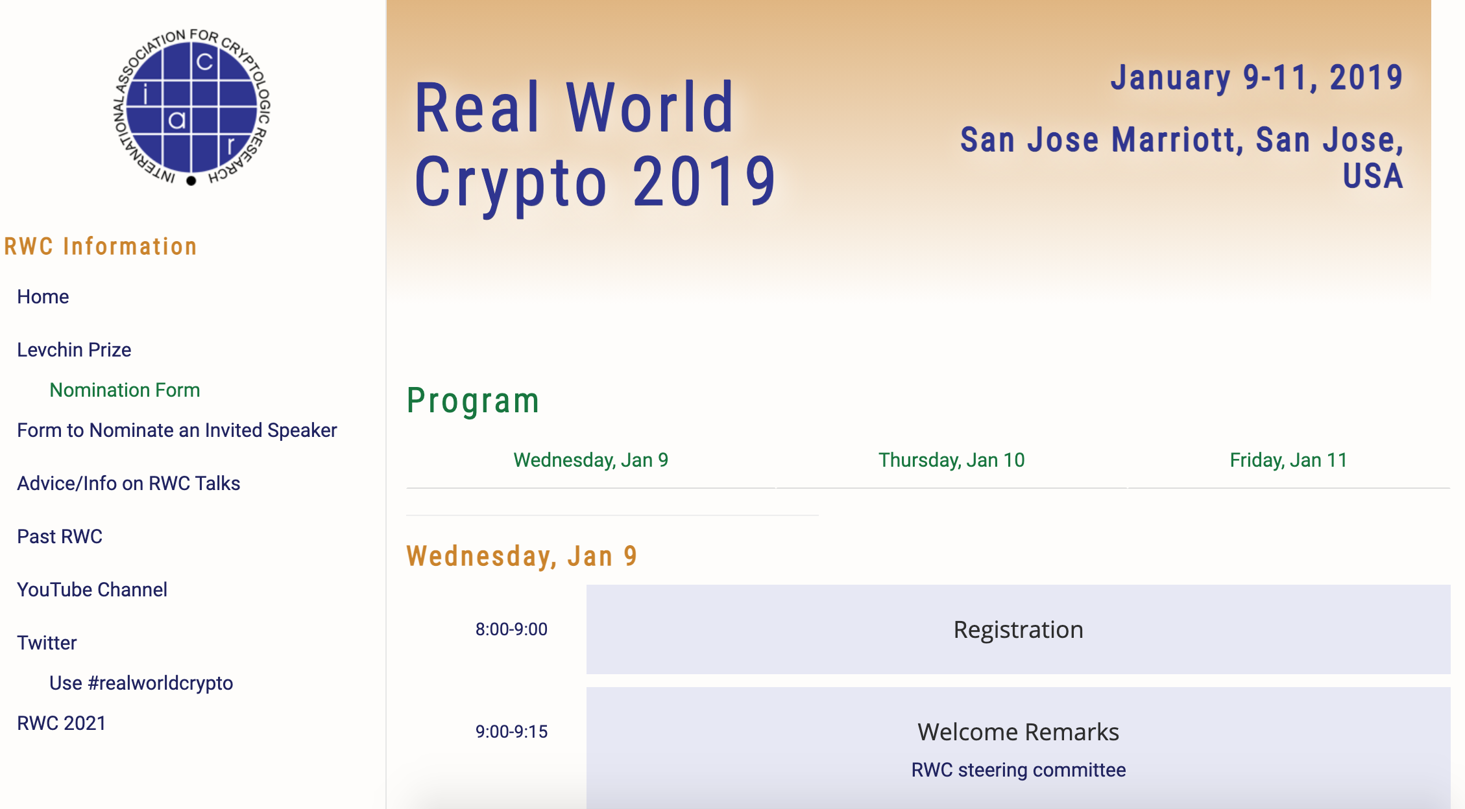
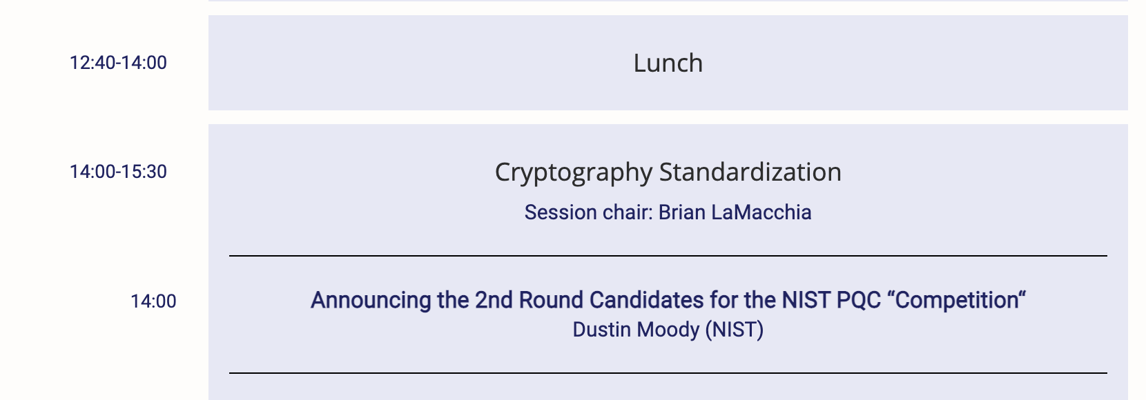
2 years ago….

Slide 3
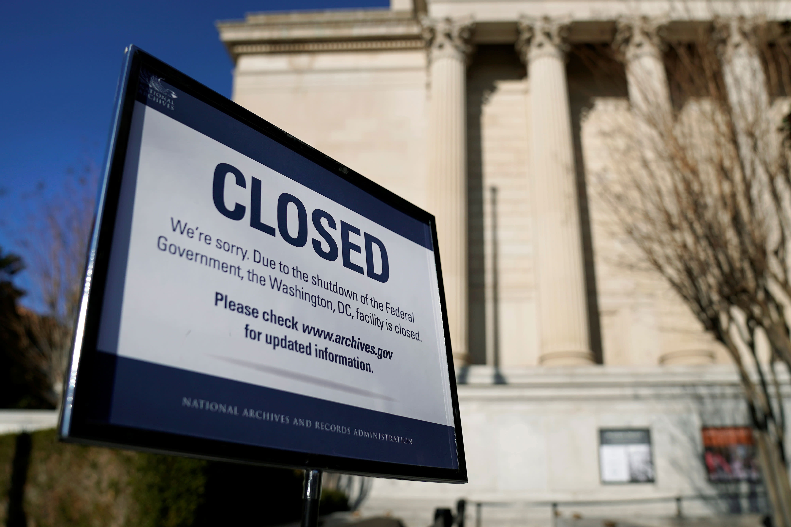
2 years ago….

Slide 4
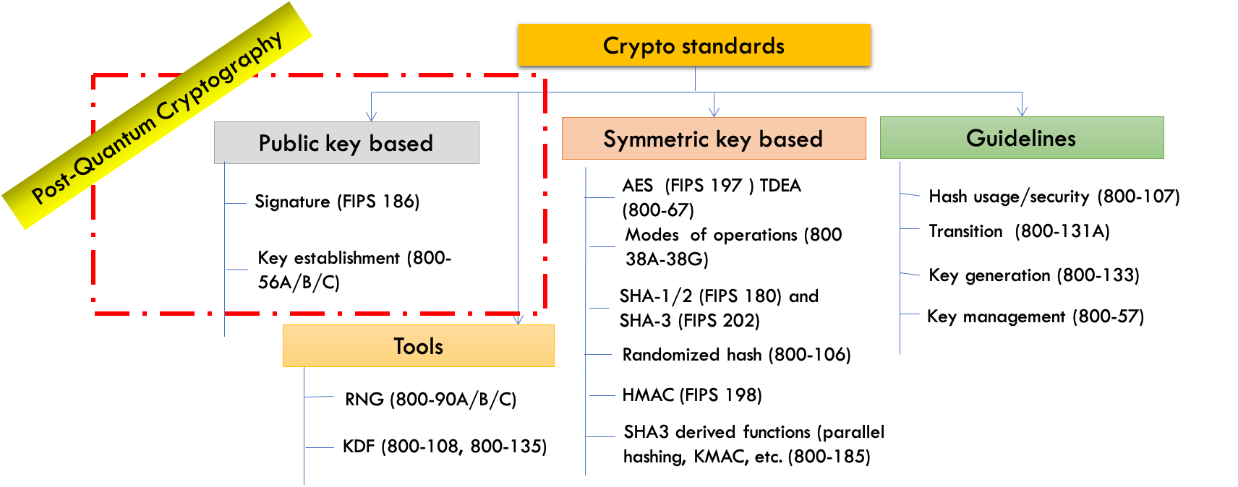
The Quantum Threat
NIST public-key crypto standards
  SP 800-56A: Recommendation for Pair-Wise Key-Establishment Schemes Using Discrete Logarithm Cryptography
  SP 800-56B: Recommendation for Pair-Wise Key-Establishment Using Integer Factorization Cryptography
  FIPS 186: The Digital Signature Standard
vulnerable to attacks from a (large-scale) quantum computer
Shor’s algorithm would break RSA, ECDSA, (EC)DH, DSA
Symmetric-key crypto standards would also be affected, but less dramatically

Slide 5
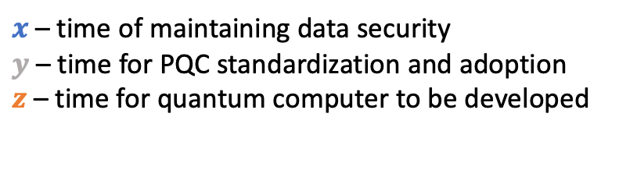
Post-Quantum Cryptography
Post-Quantum Cryptography (PQC)
  Cryptosystems which run on classical computers, and are believed to be resistant to attacks from both classical and quantum computers
How soon do we need to worry?
Theorem (Mosca): If x + y > z, then worry
What do we do here??
$x$ – time of maintaining data security
$y$ – time for PQC standardization and adoption
$z$ – time for quantum computer to be developed
y
x
z
secret keys revealed
time
Notes:
Not QKD

Slide 6

When will a Quantum Computer be Built?

Slide 7
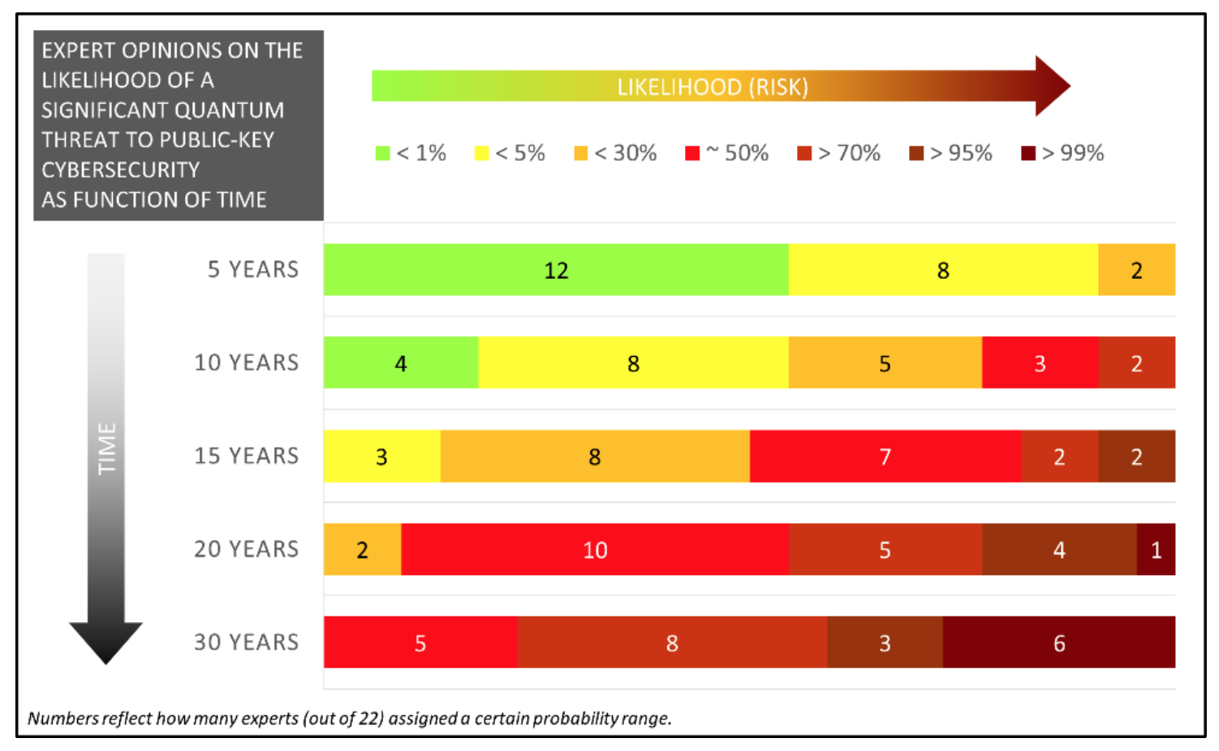
When will a Quantum Computer be Built?
Source: M. Mosca, M. Piani, Quantum Threat Timeline Report, Oct 2019
available at: https://globalriskinstitute.org/publications/quantum-threat-timeline/

Slide 8






NIST PQC Milestones and Timelines
2016
Determined criteria and requirements, published NISTIR 8105
Announced call for proposals
2017
Received 82 submissions
Announced 69 1st round candidates
2018
Held the 1st NIST PQC standardization Conference
2019
Announced 26 2nd round candidates, NISTIR 8240
Held the 2nd NIST PQC Standardization Conference
2020
Announced 3rd round 7 finalists and 8 alternate candidates. NISTIR 8309
2021
Hold the 3rd NIST PQC Standardization Conference
2022-2023
Release draft standards and call for public comments

Slide 9
Evaluation Criteria
Security – against both classical and quantum attacks
  NIST asked submitters to focus on levels 1,2, and 3. (Levels 4 and 5 are for very high security)
Performance – measured on various classical platforms
Other properties: Drop-in replacements, Perfect forward secrecy, Resistance to side-channel attacks, Simplicity and flexibility, Misuse resistance, etc.
Level | Security Description
I | At least as hard to break as AES128 (exhaustive key search)
II | At least as hard to break as SHA256 (collision search)
III | At least as hard to break as AES192 (exhaustive key search)
IV | At least as hard to break as SHA384 (collision search)
V | At least as hard to break as AES256 (exhaustive key search)

Slide 10
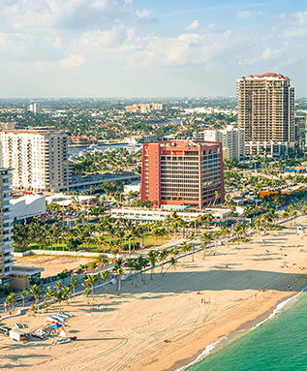
The 1st Round
A lot of schemes quickly attacked!
Many similar schemes (esp. lattice KEMs)
1st NIST PQC Standardization workshop
Over 300 ”official comments” and 900 posts on the pqc-forum
Research and performance numbers
After a year: 26 schemes move on
 | Signatures | KEM/Encryption | Overall
Lattice-based | 5 | 21 | 26
Code-based | 2 | 17 | 19
Multi-variate | 7 | 2 | 9
Stateless Hash or Symmetric based | 3 |  | 3
Other | 2 | 5 | 7
Total | 19 | 45 | 64

Slide 11
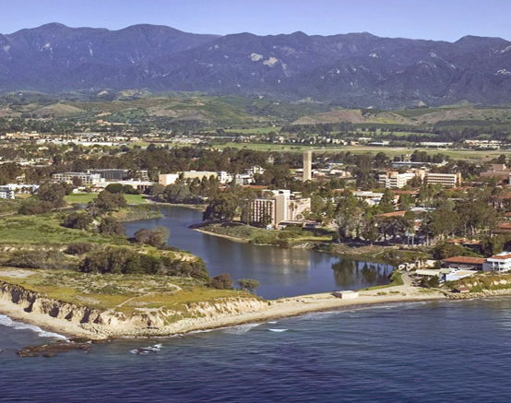
The 2nd Round
4 merged submissions
Maintained diversity of algorithms
Cryptanalysis continued
    7 of the 26 round 2 schemes were broken
2nd NIST PQC Standardization workshop
More benchmarking and real world
experiments
After 18 months: 15 submissions move on
 | Signatures | KEM/Encryption | Overall
Lattice-based | 3 | 9 | 12
Code-based |  | 7 | 7
Multi-variate | 4 |  | 4
Stateless Hash or Symmetric based | 2 |  | 2
Isogeny |  | 1 | 1
Total | 10 | 16 | 26

Slide 12
The 1st Round Candidates
BIG QUAKE
BIKE
CFPKM
Classic McEliece
Compact LWE
CRYSTALS-DILITHIUM
CRYSTALS-KYBER
DAGS
Ding Key Exchange
DME
DRS
DualModeMS
Edon-K
EMBLEM/R.EMBLEM
FALCON
FrodoKEM
GeMSS
Giophantus
Gravity-SPHINCS
Guess Again
Gui
HILA5
HiMQ-3
HK-17
HQC
KCL
KINDI
LAC
LAKE
LEDAkem
LEDApkc
Lepton
LIMA
Lizard
LOCKER
LOTUS
LUOV
McNie
Mersenne-756839
MQDSS
NewHope
NTRUEncrypt
NTRU-HRSS-KEM
NTRU Prime
NTS-KEM
Odd Manhattan
Ouroboros-R
Picnic
Post-quantum RSA Encryption
Post-quantum RSA Signature
pqNTRUSign
pqsigRM
QC-MDPC-KEM
qTESLA
RaCoSS
Rainbow
Ramstake
RankSign
RLCE-KEM
Round2
RQC
RVB
SABER
SIKE
SPHINCS+
SRTPI
Three Bears
Titanium
WalnutDSA

Slide 13
The 2nd Round Candidates
BIG QUAKE
BIKE
CFPKM
Classic McEliece
Compact LWE
CRYSTALS-DILITHIUM
CRYSTALS-KYBER
DAGS
Ding Key Exchange
DME
DRS
DualModeMS
Edon-K
EMBLEM/R.EMBLEM
FALCON
FrodoKEM
GeMSS
Giophantus
Gravity-SPHINCS
Guess Again
Gui
HILA5
HiMQ-3
HK-17
HQC
KCL
KINDI
LAC
LAKE
LEDAkem
LEDApkc
Lepton
LIMA
Lizard
LOCKER
LOTUS
LUOV
McNie
Mersenne-756839
MQDSS
NewHope
NTRUEncrypt
NTRU-HRSS-KEM
NTRU Prime
NTS-KEM
Odd Manhattan
Ouroboros-R
Picnic
Post-quantum RSA Encryption
Post-quantum RSA Signature
pqNTRUSign
pqsigRM
QC-MDPC-KEM
qTESLA
RaCoSS
Rainbow
Ramstake
RankSign
RLCE-KEM
Round2
RQC
RVB
SABER
SIKE
SPHINCS+
SRTPI
Three Bears
Titanium
WalnutDSA
LEDAcrypt
NTRU
Rollo
Round5

Slide 14




Challenges and Considerations in Selecting Algorithms
Security
  Security levels offered
  (confidence in) security proof
  Any attacks
  Classical/quantum complexity
Performance
  Size of parameters
  Speed of KeyGen, Enc/Dec, Sign/Verify
  Decryption failures
Algorithm and implementation characteristics
  IP issues
  Side channel resistance
  Simplicity and clarity of documentation
  Flexible
Other
  Round 2 changes
  Official comments/pqc-forum discussion
  Papers published/presented
1st round
2nd round
3rd round

Slide 15
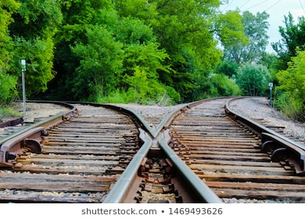
Two Tracks
Finalists
  Algorithms that could be ready to be standardized at the end of the 3rd round
  Most promising to fit the majority of use cases
The 2nd track: Alternates
  Crucial point – had to have potential for standardization
  not just be of interest for future research
Notes:
Debate over 1 track or 2

Slide 16
The 3rd Round Finalists and Alternates
NIST selected 7 Finalists and 8 Alternates
KEM finalists: Kyber, NTRU, SABER, Classic McEliece
Signature finalists: Dilithium, Falcon, Rainbow
 | Signatures |  | KEM/Encryption |  | Overall
Lattice-based | 2 |  | 3 | 2 | 5 | 2
Code-based |  |  | 1 | 2 | 1 | 2
Multi-variate | 1 | 1 |  |  | 1 | 1
Stateless Hash or Symmetric based |  | 2 |  |  |  | 2
Isogeny |  |  |  | 1 |  | 1
Total | 3 | 3 | 4 | 5 | 7 | 8
KEM alternates:
  Bike, FrodoKEM, HQC, NTRUprime, SIKE
Signature alternates:
  GeMSS, Picnic, Sphincs+
Notes:
Talk about narrowing it down. Some attacked.
Merger, lattice KEMS.
Two buckets
Had to eliminate some good schemes (New hope, 3 bears)
Explained in our report about all 26 (unlike 1st report).
Explain 1 of Kyber/NTRU/Saber and Dilithium/Falcon. They’re balanced
Explain CM and Rainbow.
Talk about each.

Slide 17
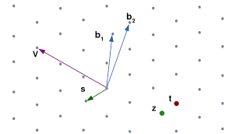
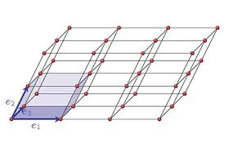
Lattice-based KEMs
Crystals-Kyber
  Great all-around → Finalist
Saber
  Great all-around → Finalist
NTRU
  Older, clear IP situation → Finalist
NTRUprime
  Different design choices → Alternate
FrodoKEM
  Conservative/Backup → Alternate
Notes:
Needed to focus analysis, thus not take too many

Slide 18
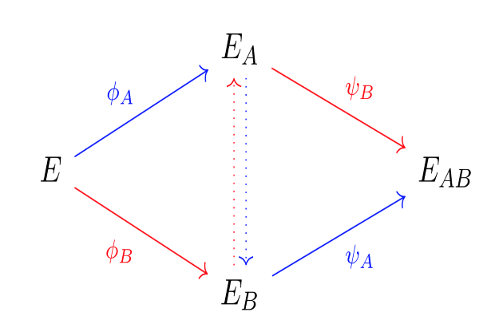
Isogeny- and Code-based KEMs
(001)
(011)
Classic McEliece
  Oldest submission, large public keys but small ciphertexts→ Finalist
BIKE
  Good performance, CCA security?, more time to be stable → Alternate
HQC
  Better security analysis/larger keys (than BIKE) → Alternate
SIKE
  Newer security problem, an order slower → Alternate
(101)
(111)
(000)
(010)
(100)
(110)
Notes:
Strong desire to standardize a code-based one, but needed a 4th round for BIKE or HQC.

Slide 19
The Signatures
Dilithium and Falcon
  Both balanced, efficient lattice-based signatures
  → Finalists
SPHINCS+ and Picnic
  SPHINCS+ is stable, conservative security, larger/slower → Alternate
  Picnic not stable yet, but has lots of potential → Alternate
Rainbow and GeMMS
  Both have large public keys, small signatures. Rainbow a bit better → Finalist, GeMMS → Alternate

Slide 20
Round 3 Cryptanalysis
Multivariate signature schemes Rainbow and GeMSS
Both substantially attacked by new MinRank-style attacks [Beullens and Tao/Petzoldt/Ding]
(Was not part of end-of-2nd-Round decision-making)
Rainbow loses ~16 bits of security at Level 1, and ~55 bits of security at Level 5
(Rainbow team proposes new security analysis accounting for memory costs – correct?)
GeMSS loses up to 71 bits of security at Level 1, and up to 196 bits of security at Level 5
Notably, there seems to be very little security gain between their Level 1 and Level 5 parameter sets now

Slide 21
State of the signature schemes
Dilithium – lattice based
Falcon – lattice-based
SPHINCS+ - hash-based
Picnic – ZKP/MPC-in-the head
Rainbow – multivariate
GeMSS - multivariate
From our 2nd Round Report (NISTIR 8309):
  "NIST sees SPHINCS+ as an extremely conservative choice for standardization. If NIST’s confidence in better performing signature algorithms is shaken by new analysis , SPHINCS+ could provide an immediately available algorithm for standardization at the end of the third round. "
  “NIST is pleased with the progress of the PQC standardization effort but recognizes that current and future research may lead to promising schemes which were not part of the NIST PQC Standardization Project. NIST may adopt a mechanism to accept such proposals at a later date. In particular, NIST would be interested in a general-purpose digital signature scheme which is not based on structured lattices.”

Slide 22
Timeline
The 3rd round will last 12-18 months
  NIST will then select which finalist algorithms to standardize
  NIST will also select which alternates to keep studying in a 4th round (*)
  The 4th round will similarly be 12-18 months
  NIST may decide to consider new schemes at some point
NIST will hold a virtual 3rd PQC Standardization Conference
  We are planning for late May – early June 2021
We expect to release draft standards for public comment in 2022-2023
The finalized standard will hopefully be ready by 2024
Notes:
(*) There is a chance we could standardize an alternate

Slide 23
Research Challenges
Many important topics to be studied:
  Security proofs in both the ROM and QROM
  Does the specific ring/module/field choice matter for security?
    Or choice of noise distribution?
    Does “product” or “quotient” style LWE matter?
  Finer-grained metrics for security of lattice-based crypto (coreSVP vs. real-world security)
  Are there any important attack avenues that have gone unnoticed?
  Side-channel attacks/resistant implementations for finalists and alternates
  More hardware implementations
  Ease of implementations – decryption failures, floating point arithmetic, noise sampling, etc.
Specific algorithm questions
  Decoding analysis for BIKE, category 1 security levels for Kyber/Saber/Dilithium, algebraic cryptanalysis of cyclotomics for lattices, etc…

Slide 24
Other Challenges
Many other challenges to work on
  IP issues
  Continued performance benchmarking in different platforms and environments
    For hardware – NIST suggested Artix-7 and Cortex M4 (with all options) for easier comparison
  Real world experiments
    How do these algorithms work in actual protocols and applications.
      Are some key sizes too large?
  Transition
    Hybrid solutions – combining classical and PQC algorithms. Allowed in SP 800-56C, Rev. 2 (Aug 2020)
    NIST will issue more guidance in the coming years
Notes:
Amazon, Cisco, Google, Cloudflare, and others have done experiments with PQC algorithms in real-world protocols
“In addition to the currently approved techniques for the generation of the shared secret Z as specified in SP 800-56A and SP 800-56B, this Recommendation permits the use of a “hybrid” shared secret of the form Z′ = Z || T, a concatenation consisting of a “standard” shared secret Z that was generated during the execution of a key-establishment scheme (as currently specified in [SP 800-56A] or [SP 800-56B]) followed by an auxiliary shared secret T that has been generated using some other method” KDF (Z||T)

Slide 25
NIST Transition Guideline for PQC?
NIST has published transition guidelines for algorithms and key lengths
  NIST SP 800-131A Revision 2 “Transitioning the Use of Cryptographic Algorithms and Key Lengths” - Examples
    Three-key Triple DES
      Encryption - Deprecated through 2023 Disallowed after 2023
      Decryption - Legacy use
    SHA-1
      Digital signature generation - Disallowed, except where specifically allowed by NIST protocol-specific guidance
      Digital signature verification - Legacy use
      Non-digital signature applications – Acceptable
    Key establishment methods with strength < 112 bits (e.g. DH mod p, |p| < 2048 )
      Disallowed
NIST will provide transition guidelines to PQC standards
  The timeframe will be based on a risk assessment of quantum attacks
  NCCoE hosted a workshop on Considerations in Migrating to Post-Quantum Cryptographic Algorithms on October 7

Slide 26
Stateful Hash Based Signatures for Early Adoption
Stateful hash-based signatures were proposed in 1970s
  Rely on assumptions on hash functions, that is, not on number theory complexity assumptions
  It is essentially limited-time signatures, which require state management
NIST specification on stateful hash-based signatures
  NIST SP 800-208 “Recommendation for Stateful Hash-Based Signature Schemes”
Internet Engineering Task Force (IETF) has released two RFCs on hash-based signatures
  RFC 8391 “XMSS: eXtended Merkle Signature Scheme” (By Internet Research Task Force (IRTF))
  RFC 8554 “Leighton-Micali Hash-Based Signatures” (By Internet Research Task Force (IRTF))
ISO/IEC JTC 1 SC27 WG2 Project on hash-based signatures
  Stateful hash-based signatures will be specified in ISO/IEC 14888 Part 4
  It is in the 1st Working Draft stage

Slide 27
What can organizations do now?
Perform a quantum risk assessment within your organization
  Identify information assets and their current crypto protection
  Identify what ‘x’, ‘y’, and ‘z’ might be for you – determine your quantum risk
  Prioritize activities required to maintain awareness, and to migrate technology to quantum-safe solutions
Evaluate vendor products with quantum safe features
  Know which products are not quantum safe
  Ask vendors for quantum safe features in procurement templates
Develop an internal knowledge base amongst IT staff
Track developments in quantum computing and quantum safe solutions, and to establish a roadmap to quantum readiness for your organization
Act now – it will be less expensive, less disruptive, and less likely to have mistakes caused by rushing and scrambling

Slide 28

Conclusion
We can start to see the end?
NIST is grateful for everybody’s efforts
Check out www.nist.gov/pqcrypto
  Sign up for the pqc-forum for announcements & discussion
  send e-mail to pqc-comments@nist.gov

